Slide 1
0
1
Introduction: Evolution and the Foundations of Biology

Slide 2
Overview: Inquiring About Life
An organism’s adaptations to its environment are the result of evolution
For example, a beach mouse’s light, dappled fur acts as camouflage, allowing the mouse to blend into its surroundings
Inland mice of the same species are darker in color, matching their surroundings
Evolution is the process of change that has transformed life on Earth
Notes:
2

Slide 3
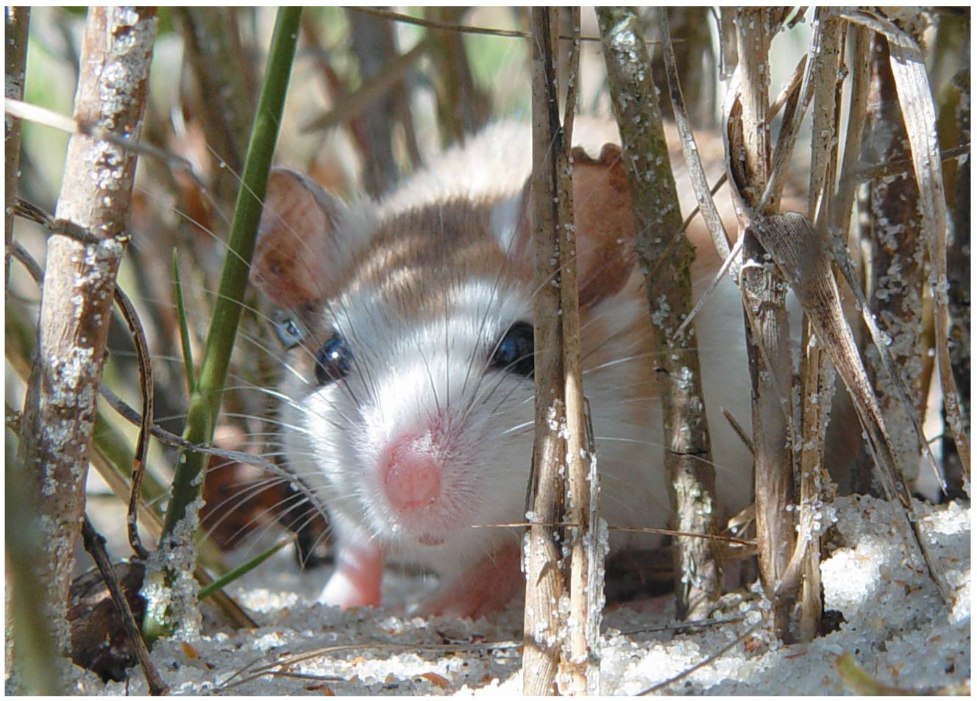
Figure 1.1
Notes:
3
Figure 1.1 What can this beach mouse teach us about biology?

Slide 4
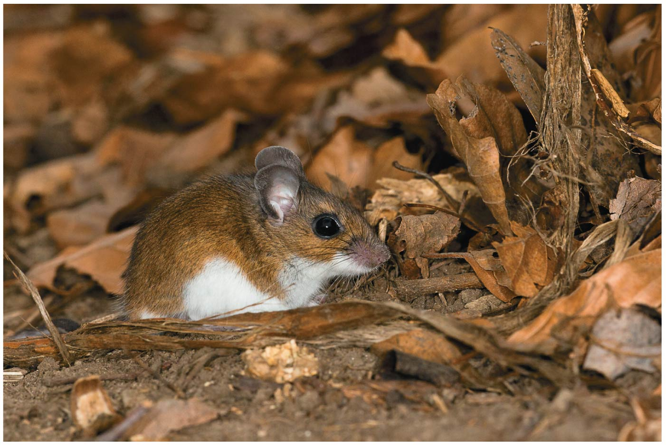
Figure 1.2
Notes:
4
Figure 1.2 An “inland” oldfield mouse (Peromyscus polionotus)

Slide 5
Biology is the scientific study of life
Biologists ask questions such as
How does a single cell develop into an organism?
How does the human mind work?
How do different forms of life in a forest interact?
Notes:
5
Click to add notes

Slide 6
Concept 1.1: Studying the diverse forms of life reveals common themes
To organize and make sense of all the information encountered in biology, focus on a few big ideas
These unifying themes help to organize biological information
Notes:
6

Slide 7
Theme: New Properties Emerge at Successive Levels of Biological Organization
Life can be studied at different levels, from molecules to the entire living planet
The study of life can be divided into different levels of biological organization
In reductionism, complex systems are reduced to simpler components to make them more manageable to study
Notes:
7

Slide 8
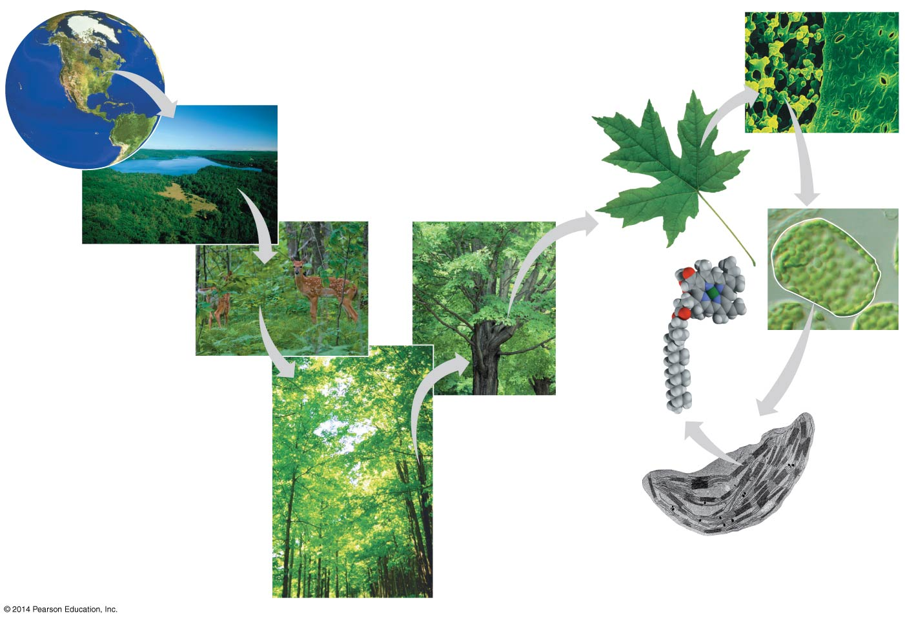
Figure 1.3
1 The
Biosphere
7
Tissues
6 Organs
and Organ
Systems
2
Ecosystems
10
Mole-
cules
3
Communities
8
Cells
5
Organisms
4
Populations
9 Organelles
Notes:
8
Figure 1.3 Exploring levels of biological organization

Slide 9
Emergent Properties
Emergent properties result from the arrangement and interaction of parts within a system
Emergent properties characterize nonbiological entities as well
For example, a functioning bicycle emerges only when all of the necessary parts connect in the correct way
Notes:
9

Slide 10
Biologists today combine reductionism with systems biology, the exploration of a biological system by analyzing the interactions among its parts
The systems approach poses questions such as
How does a drug for blood pressure affect other organs?
How does increasing CO₂ alter the biosphere?
Notes:
10

Slide 11
Structure and Function
At each level of the biological hierarchy we find a correlation between structure and function
Analyzing a biological structure can give clues about what it does and how it works
Notes:
11

Slide 12
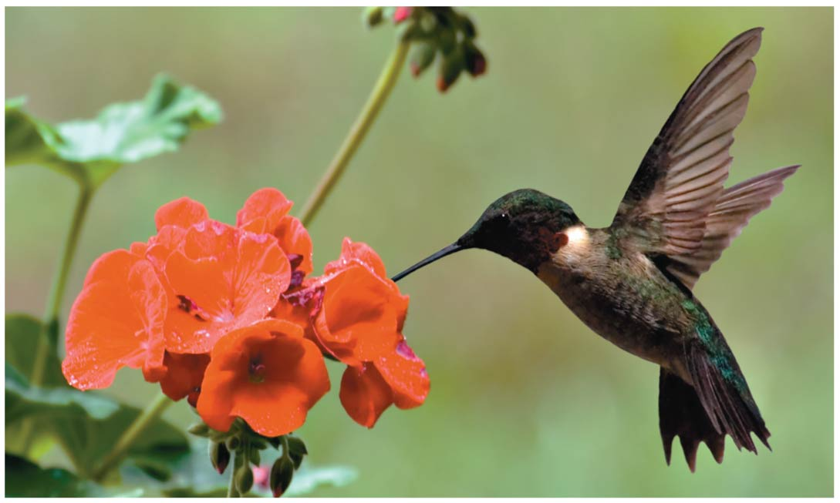
Figure 1.4
Notes:
12
Figure 1.4 Form fits function in a hummingbird’s body

Slide 13
The Cell: An Organism’s Basic Unit of Structure and Function
The cell is the smallest unit of life that can perform all the required activities
All cells share certain characteristics, such as being enclosed by a membrane
The two main forms of cells are prokaryotic and eukaryotic
Notes:
13

Slide 14
A eukaryotic cell contains membrane-enclosed organelles, including a DNA-containing nucleus
Some organelles, such as the chloroplast, are limited only to certain cell types, that is, those that carry out photosynthesis
Prokaryotic cells lack a nucleus or other membrane-bound organelles and are generally smaller than eukaryotic cells
Notes:
14

Slide 15
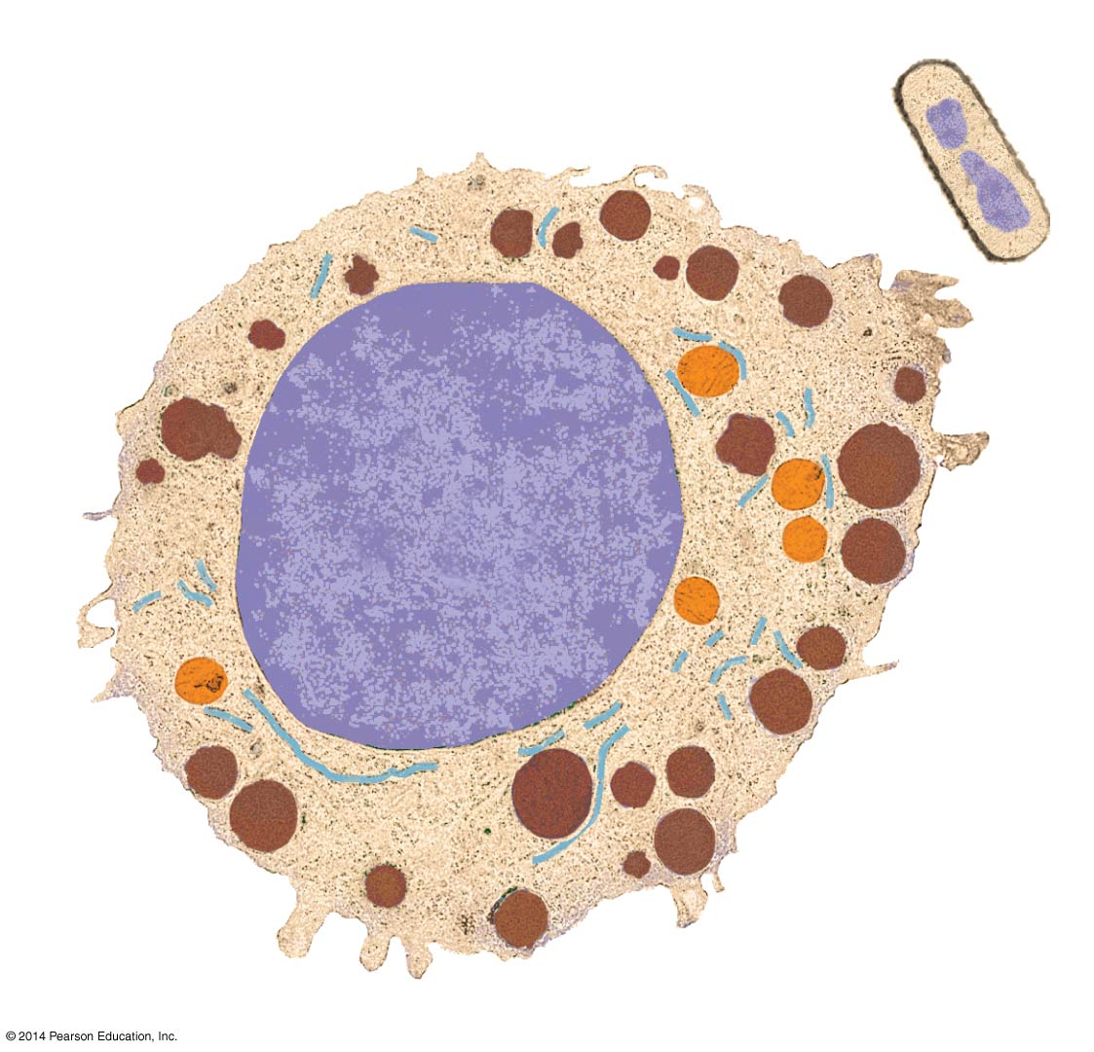
Figure 1.5
Prokaryotic cell
Eukaryotic cell
DNA
(no nucleus)
Membrane
Membrane
Cytoplasm
Nucleus
(membrane-
enclosed)
Membrane-
enclosed organelles
DNA (throughout
nucleus)
1 μm
Notes:
15
Figure 1.5 Contrasting eukaryotic and prokaryotic cells in size and complexity

Slide 16
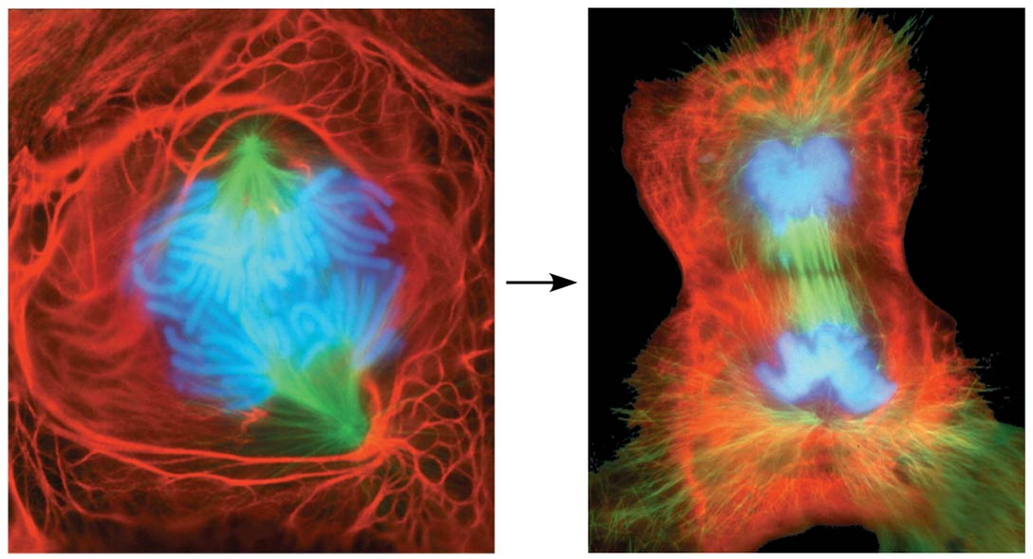
Theme: Life’s Processes Involve the Expression and Transmission of Genetic Information
Chromosomes contain most of a cell’s genetic material in the form of DNA (deoxyribonucleic acid)
Notes:
16

Slide 17
DNA Structure and Function
A DNA molecule holds hundreds or thousands of genes, each a stretch of DNA along the chromosome
Genes are the units of inheritance that transmit information from parents to offspring
As cells grow and divide, the genetic information encoded by DNA directs their development
Notes:
17

Slide 18
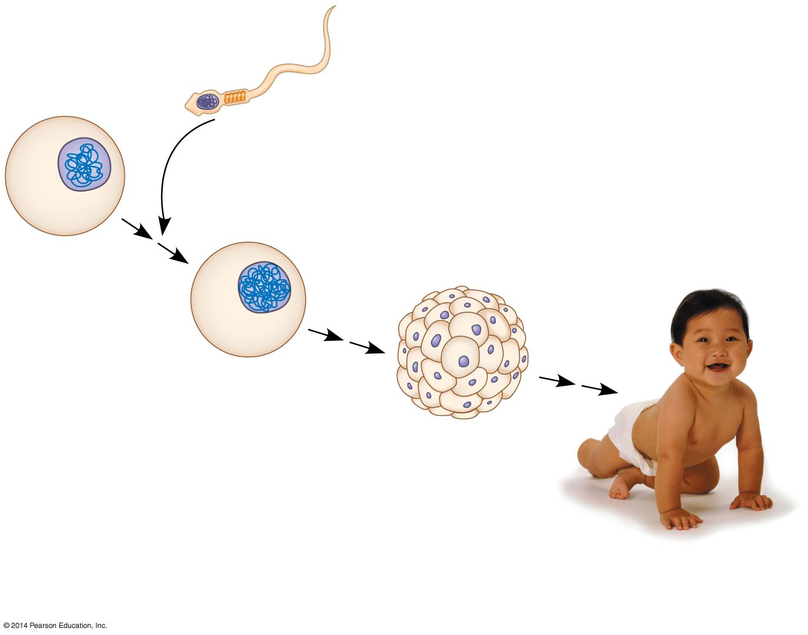
Figure 1.7
Nucleus with DNA
Sperm cell
Fertilization
Egg cell
Fertilized egg
with DNA from
both parents
Embryo’s cells
with copies of
inherited DNA
Offspring with
traits inherited
from both parents
Notes:
18
Figure 1.7 Inherited DNA directs development of an organism

Slide 19
A DNA molecule is made of two long chains (strands) arranged in a double helix
Each link of a chain is one of four kinds of chemical building blocks called nucleotides and abbreviated A, T, C, and G
Notes:
19

Slide 20
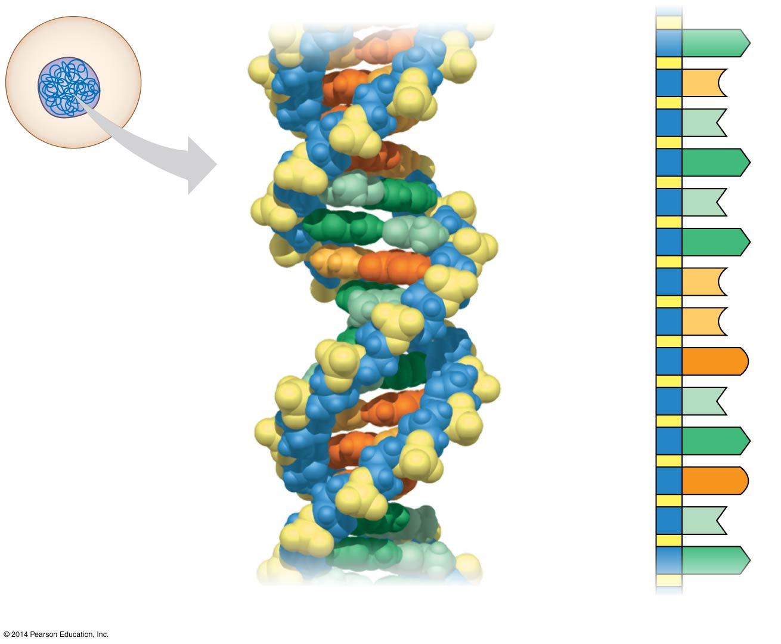
Figure 1.8
Nucleus
A
DNA
C
Nucleotide
T
Cell
A
T
A
C
C
G
T
A
G
T
A
(a) DNA double helix
(b) Single strand of DNA
Notes:
20
Figure 1.8 DNA: The genetic material

Slide 21
DNA provides blueprints for making proteins, the major players in building and maintaining a cell
Genes control protein production indirectly, using RNA as an intermediary
Gene expression is the process of converting information from gene to cellular product
Notes:
21

Slide 22
Genomics: Large-Scale Analysis of DNA Sequences
An organism’s genome is its entire set of genetic instructions
The human genome and the genomes of many other organisms have been sequenced using DNA-sequencing machines
Genomics is the study of sets of genes within and between species
Notes:
22

Slide 23
“High-throughput” technology refers to tools that can analyze biological materials very rapidly
Bioinformatics is the use of computational tools to store, organize, and analyze the huge volume of data
Notes:
23

Slide 24
Theme: Life Requires the Transfer and Transformation of Energy and Matter
Input of energy, mainly from the sun, and transformation of energy from one form to another make life possible
Plants and other photosynthetic organisms convert the energy of sunlight into the chemical energy of sugars
This chemical energy of these producers is then passed to consumers that feed on the producers
Notes:
24

Slide 25
Energy flows through an ecosystem, generally entering as light and exiting as heat
Chemical elements are recycled within an ecosystem
Notes:
25

Slide 26
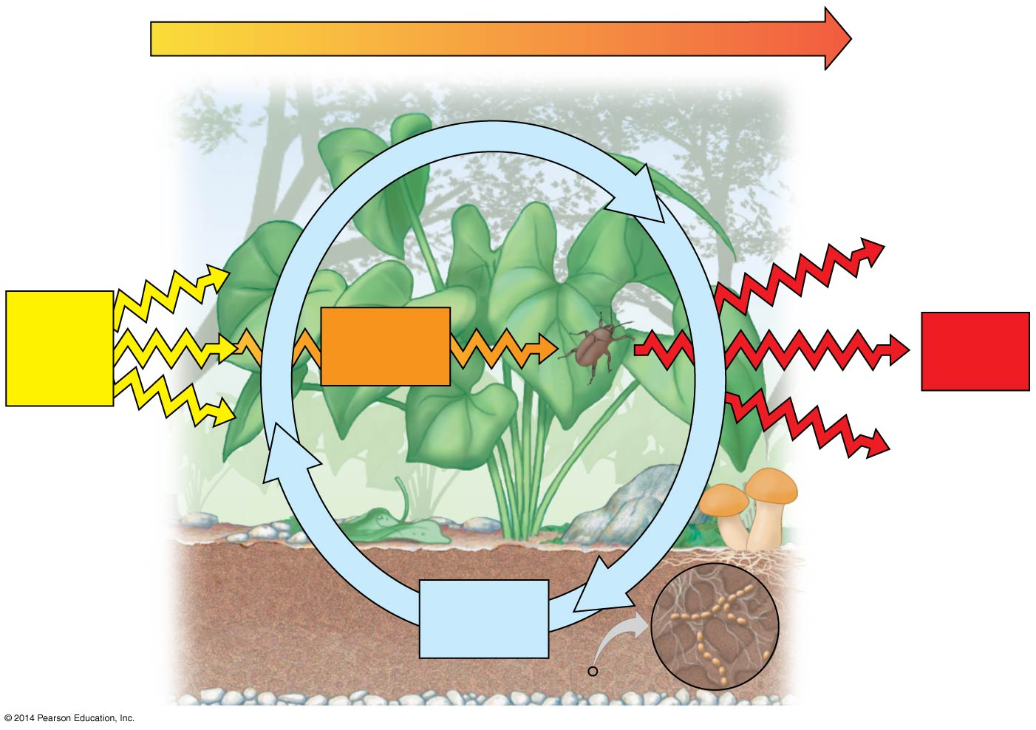
Figure 1.9
Energy flow
Chemicals
pass to
organisms
that eat plants.
Light
energy
Chemical
energy
Heat
Decomposers
return
chemicals
to soil.
Chemical
elements
Notes:
26
Figure 1.9 Energy flow and chemical cycling

Slide 27
Theme: Organisms Interact with Other Organisms and the Physical Environment
Every organism interacts with physical factors in its environment
Both organisms and their environments are affected by the interactions between them
For example, a tree takes up water and minerals from the soil and carbon dioxide from the air; the tree releases oxygen to the air, and roots help form soil
Notes:
27

Slide 28
Interactions between organisms include those that benefit both organisms and those in which both organisms are harmed
Interactions affect individual organisms and the way that populations evolve over time
Notes:
28

Slide 29
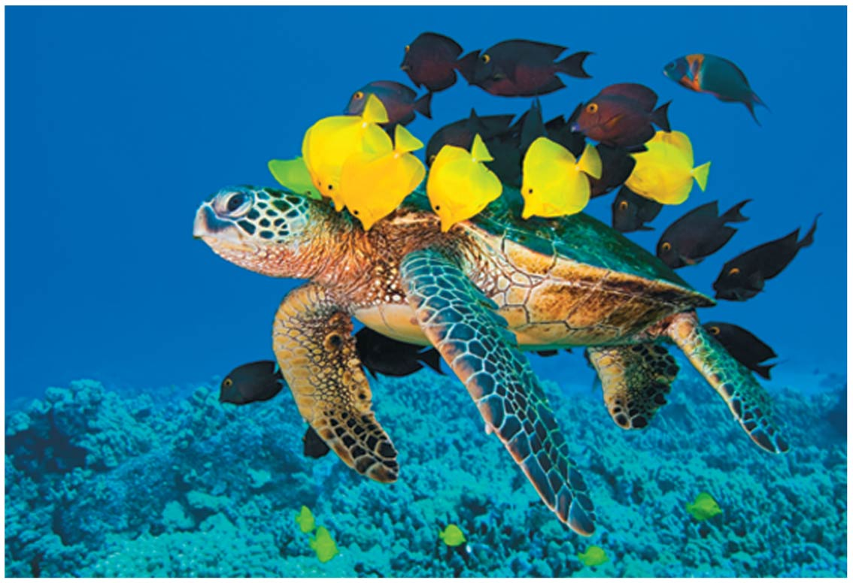
Figure 1.10
Notes:
29
Figure 1.10 An interaction between species that benefits both participants

Slide 30
Evolution, the Core Theme of Biology
Evolution makes sense of everything we know about living organisms
Evolution explains patterns of unity and diversity in living organisms
Similar traits among organisms are explained by descent from common ancestors
Differences among organisms are explained by the accumulation of heritable changes
Notes:
30

Slide 31
Concept 1.2: The Core Theme: Evolution accounts for the unity and diversity of life
The remarkably diverse forms of life on this planet arose by evolutionary processes
Notes:
31

Slide 32
Classifying the Diversity of Life: The Three Domains of Life
Humans group diverse items according to their similarities and relationships to each other
Careful analysis of form and function has been used to classify life-forms
Recently, new methods of assessing species relationships, especially comparisons of DNA sequences, have led to a reevaluation of larger groupings
Notes:
32

Slide 33
Biologists currently divide the kingdoms of life into three domains: Bacteria, Archaea, and Eukarya
Domains Bacteria and Archaea are prokaryotes
Notes:
33

Slide 34
Domain Eukarya includes all eukaryotic organisms
Domain Eukarya includes three multicellular kingdoms: Plantae, Fungi, and Animalia
Plants produce their own food by photosynthesis
Fungi absorb nutrients
Animals ingest their food
Notes:
34

Slide 35
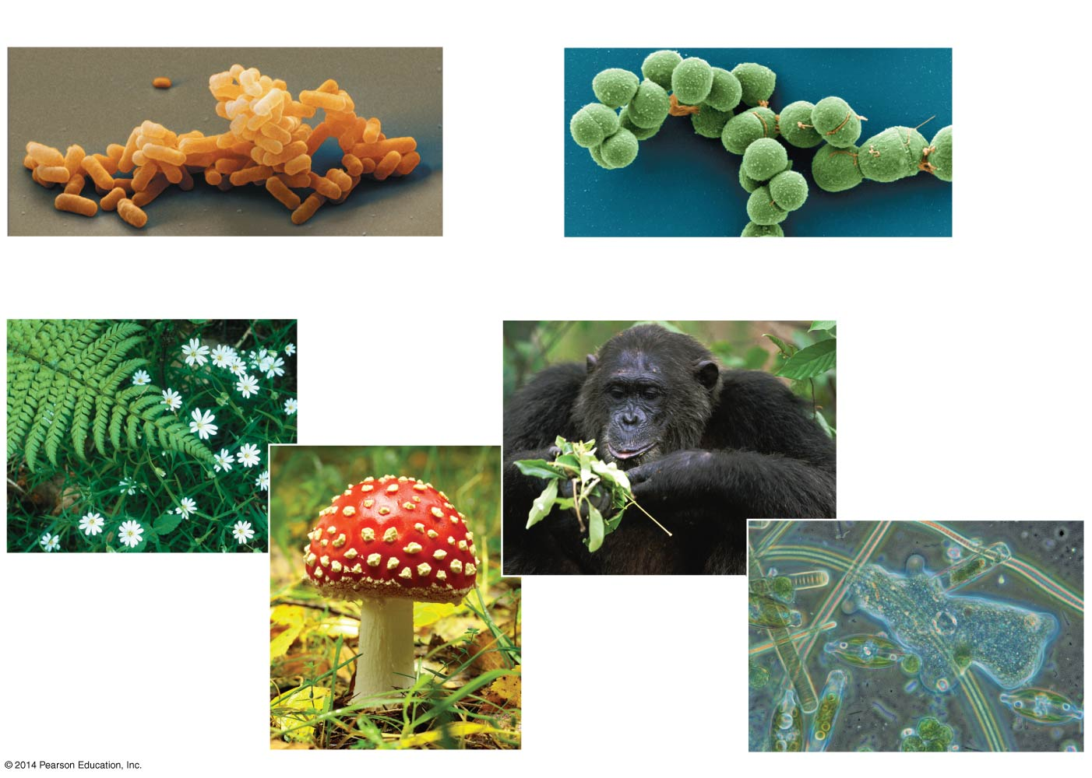
Figure 1.11
(a) Domain Bacteria
(b) Domain Archaea
2 μm
2 μm
(c) Domain Eukarya
Kingdom
Animalia
100 μm
Kingdom
Plantae
Kingdom Fungi
Protists
Notes:
35
Figure 1.11 The three domains of life

Slide 36
Unity in the Diversity of Life
A striking unity underlies the diversity of life
For example, DNA is the universal genetic language common to all organisms
Similarities between organisms are evident at all levels of the biological hierarchy
Notes:
36

Slide 37
Charles Darwin and the Theory of Natural Selection
Fossils and other evidence document the evolution of life on Earth over billions of years
Notes:
37

Slide 38
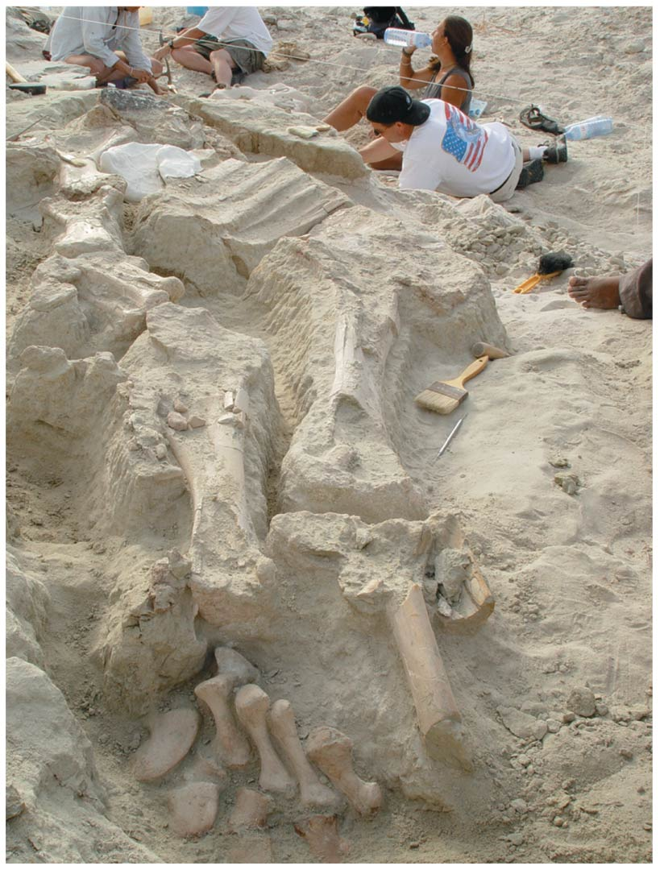
Figure 1.12
Notes:
38
Figure 1.12 Digging into the past

Slide 39
Charles Darwin published On the Origin of Species by Means of Natural Selection in 1859
Darwin made two main points
Species showed evidence of “descent with modification” from common ancestors
Natural selection is the mechanism behind “descent with modification”
Darwin’s theory captured the duality of unity and diversity
Notes:
39

Slide 40
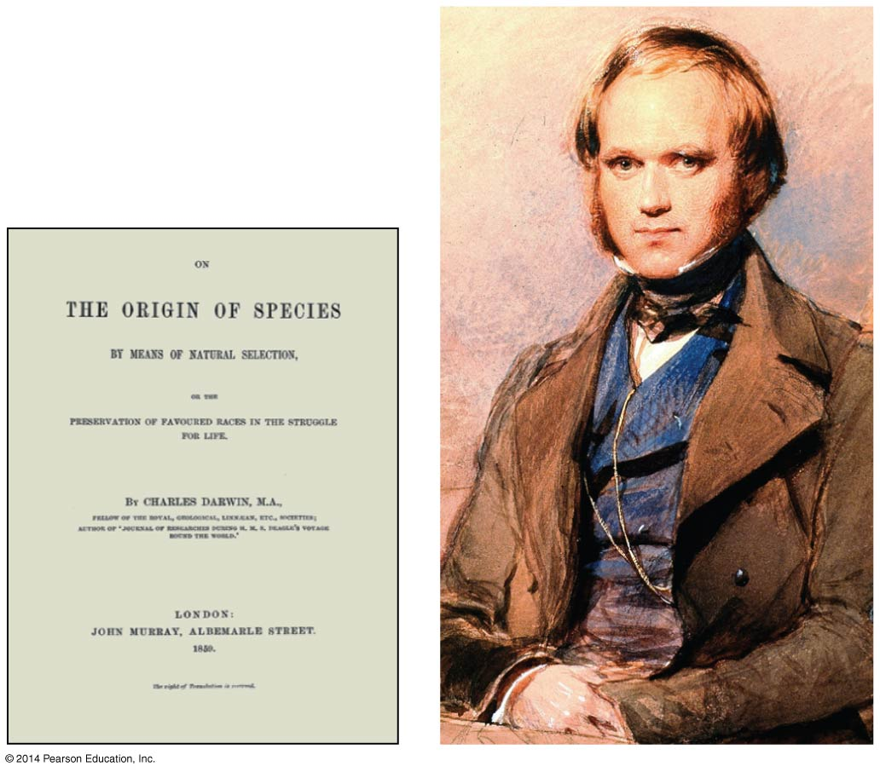
Figure 1.13
Notes:
40
Figure 1.13 Charles Darwin in 1840

Slide 41
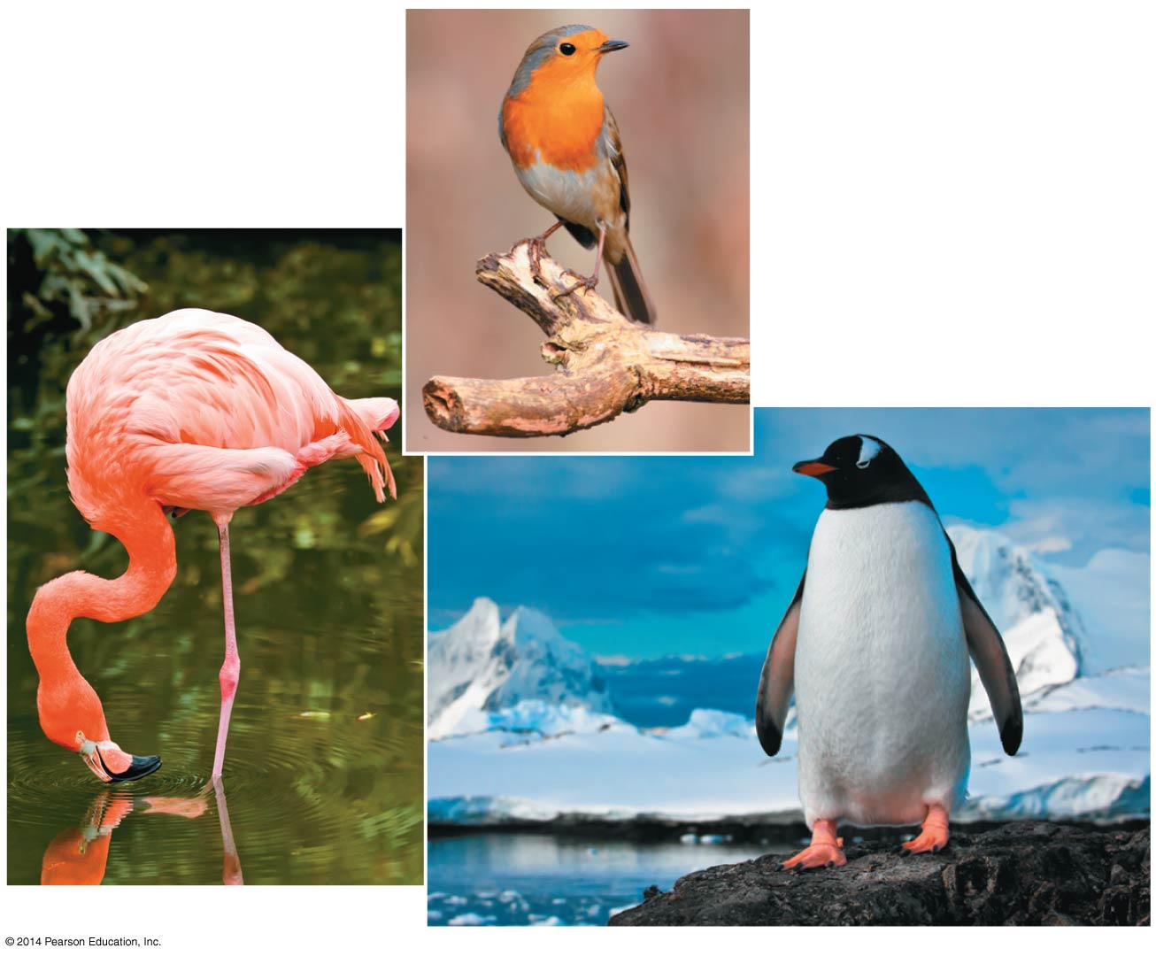
Figure 1.14
(b)
(a)
(c)
Notes:
41
Figure 1.14 Unity and diversity among birds

Slide 42
Darwin observed that
Individuals in a population vary in their traits, many of which are heritable
More offspring are produced than survive, and competition is inevitable
Species generally suit their environment
Notes:
42

Slide 43
Darwin inferred that
Individuals that are best suited to their environment are more likely to survive and reproduce
Over time, more individuals in a population will have the advantageous traits
In other words, the environment “selects” for the propagation of beneficial traits
Darwin called this process natural selection
Notes:
43

Slide 44
Figure 1.15-1
1
Population with
varied inherited
traits
Notes:
44
Figure 1.15-1 Natural selection (step 1)

Slide 45
Figure 1.15-2
1
Population with
varied inherited
traits
2
Elimination of
individuals with
certain traits
Notes:
45
Figure 1.15-2 Natural selection (step 2)

Slide 46
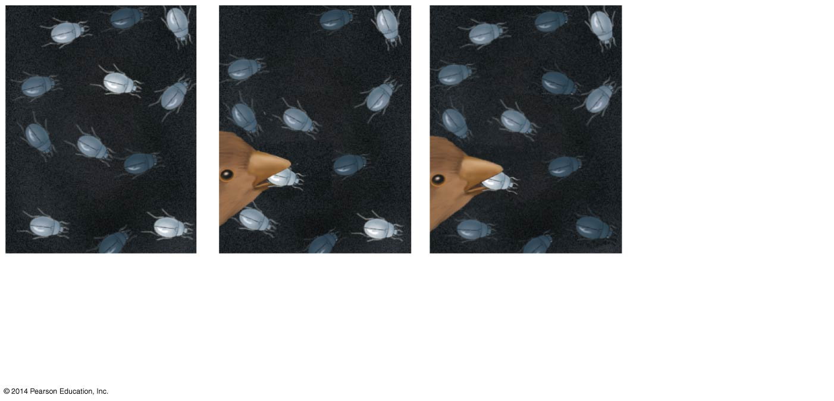
Figure 1.15-3
1
Population with
varied inherited
traits
2
Elimination of
individuals with
certain traits
3
Reproduction
of survivors
Notes:
46
Figure 1.15-3 Natural selection (step 3)

Slide 47
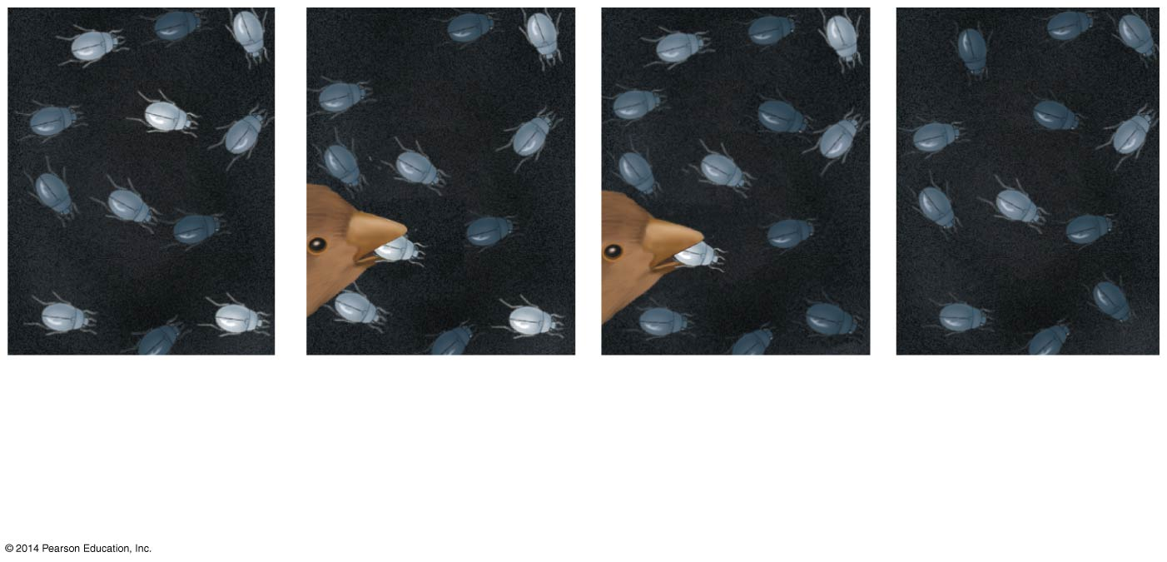
Figure 1.15-4
1
Population with
varied inherited
traits
2
Elimination of
individuals with
certain traits
3
Reproduction
of survivors
4
Increasing
frequency
of traits that
enhance
survival
Notes:
47
Figure 1.15-4 Natural selection (step 4)

Slide 48
The Tree of Life
The forelimb of a human, foreleg of a horse, flipper of a whale, and wing of a bat all share a common skeletal architecture
The shared anatomy of mammalian limbs reflects inheritance of a limb structure from a common ancestor
The diversity of mammalian limbs results from modification by natural selection over millions of years
Notes:
48

Slide 49
Darwin proposed that natural selection could cause an ancestral species to give rise to two or more descendent species
For example, the finch species of the Galápagos Islands are descended from a common ancestor
Evolutionary relationships are often illustrated with treelike diagrams that show ancestors and their descendants
Notes:
49

Slide 50
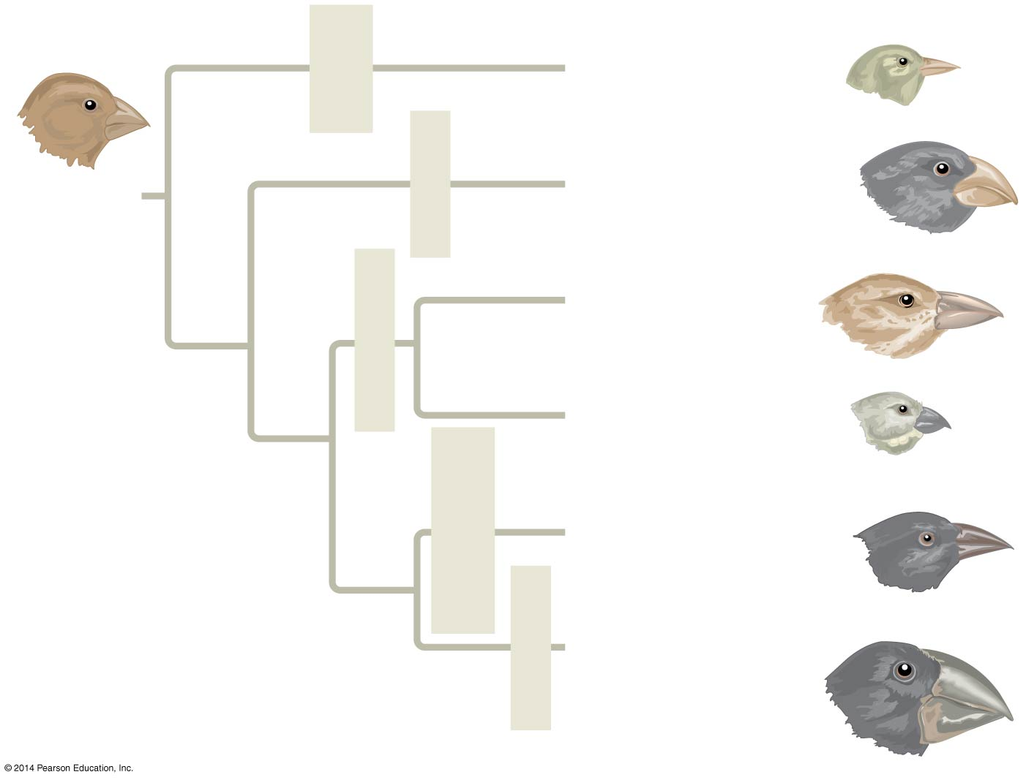
Figure 1.16
Insect-
eater
Green warbler finch
Certhidea olivacea
COMMON
ANCESTOR
Bud-eater
Vegetarian finch
Platyspiza
crassirostris
Woodpecker finch
Cactospiza pallida
Insect-eaters
Small tree finch
Camarhynchus
parvulus
Cactus-flower-
eater
Cactus ground finch
Geospiza scandens
Seed-eater
Large ground finch
Geospiza
magnirostris
Notes:
50
Figure 1.16 Descent with modification: finches on the Galápagos Islands

Slide 51
Concept 1.3: Biological inquiry entails forming and testing hypotheses based on observations of nature
The word science is derived from a Latin verb meaning “to know”
Inquiry is the search for information and explanation
The scientific process includes making observations, forming logical hypotheses, and testing them
Notes:
51

Slide 52
Making Observations
Biologists describe natural structures and processes
Recorded observations are called data
Notes:
52

Slide 53
Data fall into two categories
Qualitative data, or descriptions rather than measurements
For example, Jane Goodall’s observations of chimpanzee behavior
Quantitative data, or recorded measurements, which are sometimes organized into tables and graphs
Notes:
53

Slide 54
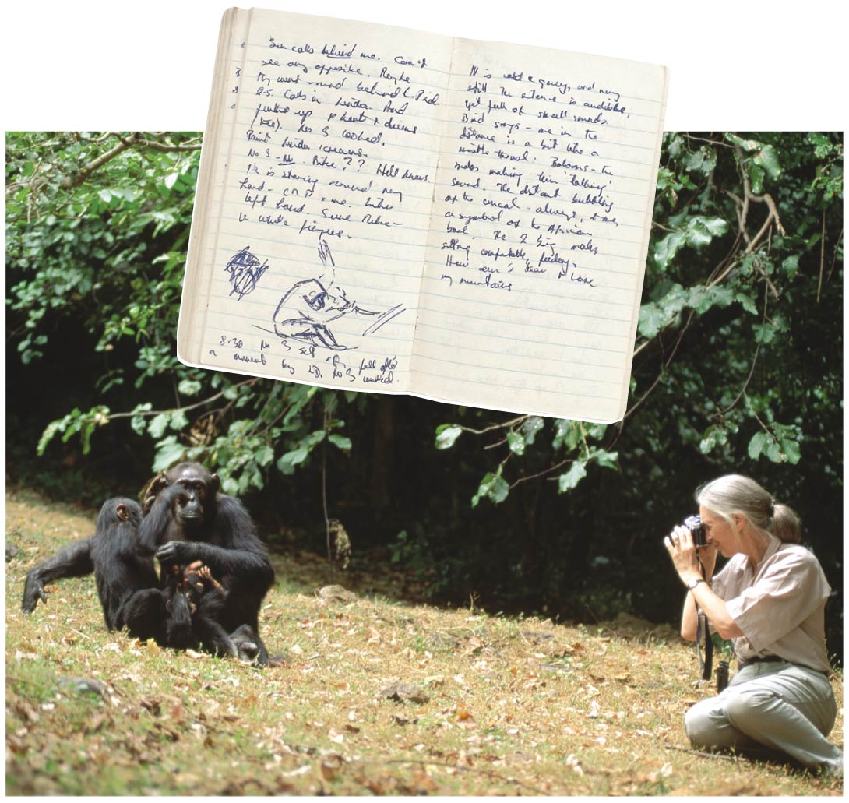
Figure 1.17
Notes:
54
Figure 1.17 Jane Goodall collecting qualitative data on chimpanzee behavior

Slide 55
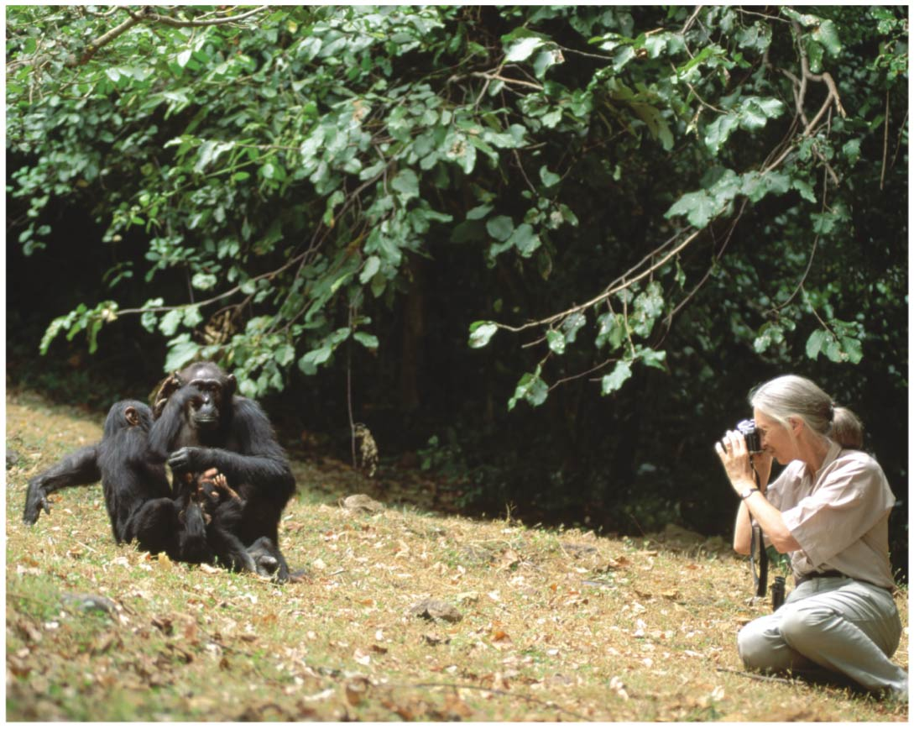
Figure 1.17a
Notes:
55
Figure 1.17a Jane Goodall collecting qualitative data on chimpanzee behavior (part 1: photo)

Slide 56
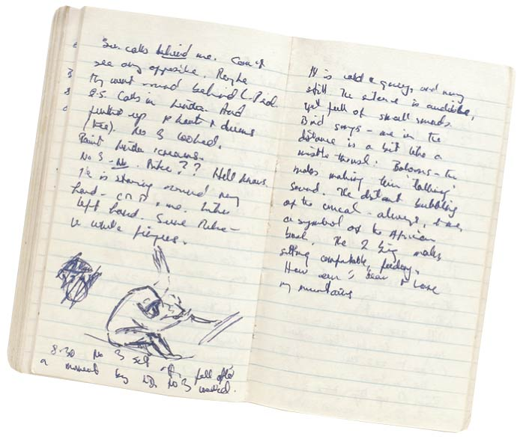
Figure 1.17b
Notes:
56
Figure 1.17b Jane Goodall collecting qualitative data on chimpanzee behavior (part 2: notebook)

Slide 57
Inductive reasoning draws conclusions through the logical process of induction
Through induction, generalizations are drawn from a large number of observations
For example, “all organisms are made of cells” was based on two centuries of microscopic observations
Notes:
57

Slide 58
Forming and Testing Hypotheses
In science, a hypothesis is a rational accounting for a set of observations, guided by inductive reasoning
It is an explanation on trial
A scientific hypothesis leads to predictions that can be tested with additional observations or an experiment
Notes:
58

Slide 59
Deductive Reasoning
Deductive reasoning extrapolates from general premises to specific predictions
The hypothesis is then tested experimentally
Notes:
59

Slide 60
The initial observations may lead to multiple hypotheses to be tested
For example
Observation: Your flashlight doesn’t work
Question: Why doesn’t your flashlight work?
Hypothesis 1: The batteries are dead
Hypothesis 2: The bulb is burnt out
Both these hypotheses are testable
Notes:
60

Slide 61
A hypothesis can never be conclusively proven to be true because we can never test all the alternatives
Hypotheses gain credibility by surviving multiple attempts at falsification, while alternative hypotheses are eliminated by testing
Notes:
61

Slide 62
Questions That Can and Cannot Be Addressed by Science
A hypothesis must be testable and falsifiable
For example, hypotheses involving supernatural explanations cannot be tested
Such explanations are outside the bounds of science
Notes:
62

Slide 63
A Case Study in Scientific Inquiry: Investigating Coat Coloration in Mouse Populations
Color patterns in animals vary widely in nature
Two mouse populations that reside in different habitats have different coat colors
What accounts for the “match” between the coat colors of the mice and the color of the sand or soil in their habitats?
Notes:
63

Slide 64
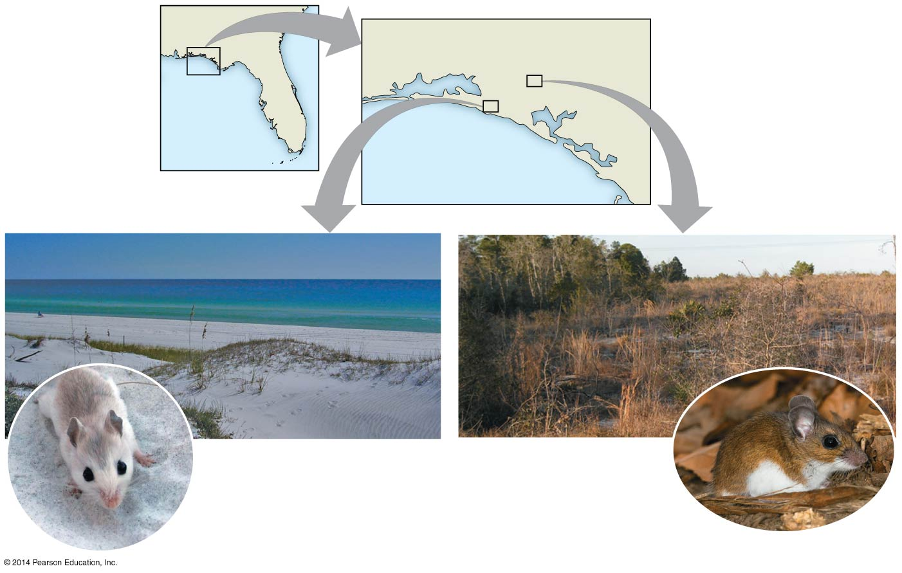
Figure 1.18
Florida
Inland
population
GULF OF MEXICO
Beach
population
Beach mice have
light tan, dappled
coats.
Members of the
same species
living inland are
darker in color.
Notes:
64
Figure 1.18 Different coloration in two beach and inland populations of Peromyscus polionotus

Slide 65
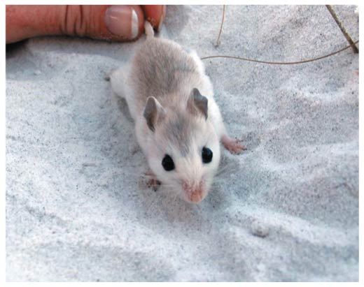
Figure 1.18a
Notes:
65
Figure 1.18a Different coloration in two beach and inland populations of Peromyscus polionotus (part 1: beach mouse)

Slide 66
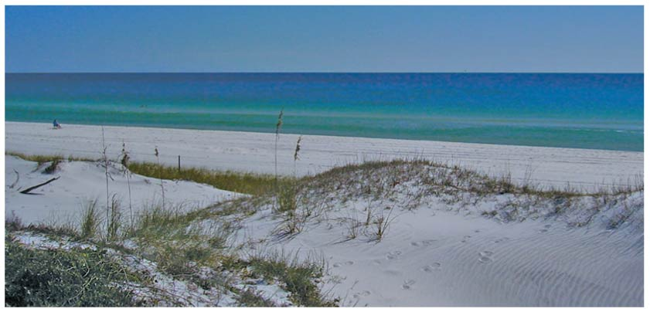
Figure 1.18b
Notes:
66
Figure 1.18b Different coloration in two beach and inland populations of Peromyscus polionotus (part 2: beach habitat)

Slide 67
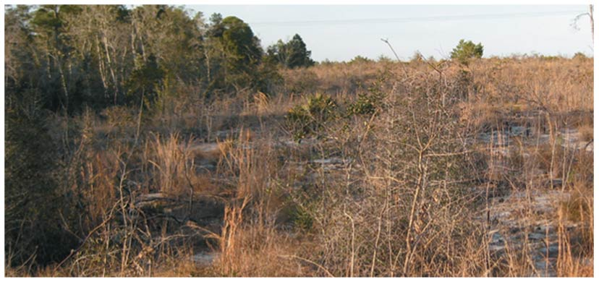
Figure 1.18c
Notes:
67
Figure 1.18c Different coloration in two beach and inland populations of Peromyscus polionotus (part 3: inland habitat)

Slide 68
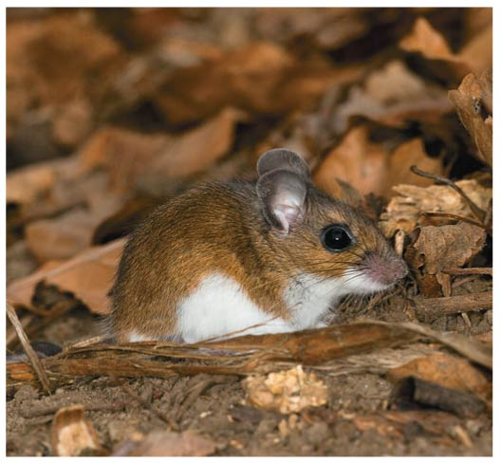
Figure 1.18d
Notes:
68
Figure 1.18d Different coloration in two beach and inland populations of Peromyscus polionotus (part 4: inland mouse)

Slide 69
The natural predators of the mice are all visual hunters
Francis Bertody Sumner hypothesized that the color patterns in the mice had evolved as adaptations that camouflage the mice to protect them from predation
Recently Hopi Hoekstra and a group of her students tested the predictions of this hypothesis
Notes:
69

Slide 70
Prediction: Mice with coloration that does not match the habitat should suffer heavier predation than the native, well-matched mice
The group built many silicone models of mice that resembled either beach or inland mice and placed equal numbers of models randomly in both habitats
The results showed that the camouflaged models suffered much lower rates of predation than the mismatched ones
Notes:
70

Slide 71
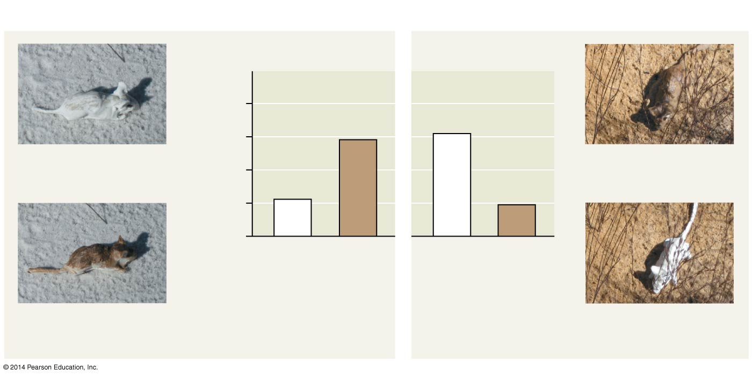
Figure 1.19
Results
1.0
Camouflaged
(control)
Predation rate
Camouflaged
(control)
0.5
0
Light
models
Dark
models
Light
models
Dark
models
Beach
habitats
Inland
habitats
Non-camouflaged
(experimental)
Non-camouflaged
(experimental)
Notes:
71
Figure 1.19 Inquiry: Does camouflage affect predation rates on two populations of mice?

Slide 72
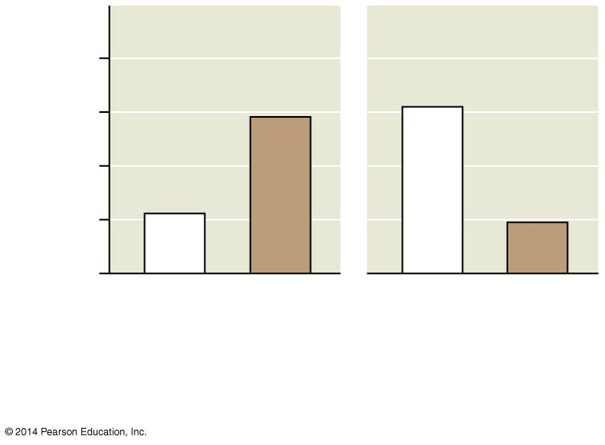
Figure 1.19a
1.0
Predation rate
0.5
0
Light
models
Dark
models
Light
models
Dark
models
Beach
habitats
Inland
habitats
Notes:
72
Figure 1.19a Inquiry: Does camouflage affect predation rates on two populations of mice? (part 1: graph)

Slide 73
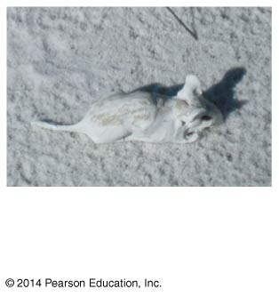
Figure 1.19b
Camouflaged
(control)
Notes:
73
Figure 1.19b Inquiry: Does camouflage affect predation rates on two populations of mice? (part 2: camouflaged beach mouse)

Slide 74
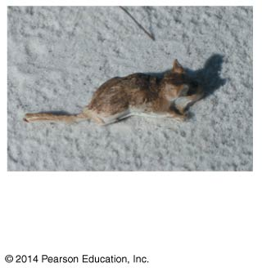
Figure 1.19c
Non-camouflaged
(experimental)
Notes:
74
Figure 1.19c Inquiry: Does camouflage affect predation rates on two populations of mice? (part 3: non-camouflaged beach mouse)

Slide 75
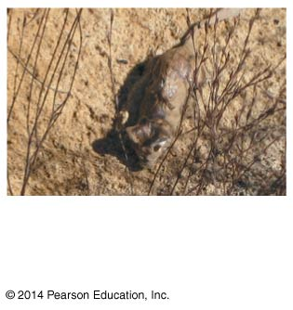
Figure 1.19d
Camouflaged
(control)
Notes:
75
Figure 1.19d Inquiry: Does camouflage affect predation rates on two populations of mice? (part 4: camouflaged inland mouse)

Slide 76
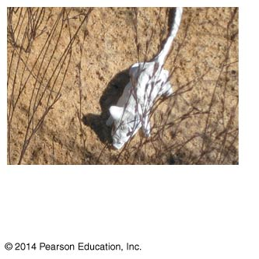
Figure 1.19e
Non-camouflaged
(experimental)
Notes:
76
Figure 1.19e Inquiry: Does camouflage affect predation rates on two populations of mice? (part 5: non-camouflaged inland mouse)

Slide 77
Experimental Controls
A controlled experiment compares an experimental group (the non-camouflaged mice) with a control group (the camouflaged mice)
Ideally, only the variable of interest (the effect of coloration on the behavior of predators) differs between the control and experimental groups
A controlled experiment means that control groups are used to cancel the effects of unwanted variables
A controlled experiment does not mean that all unwanted variables are kept constant
Notes:
77

Slide 78
Theories in Science
In the context of science, a theory is
Broader in scope than a hypothesis
General enough to lead to new testable hypotheses
Supported by a large body of evidence in comparison to a hypothesis
Notes:
78

Slide 79
Science as a Social Process: Community and Diversity
Anyone who becomes a scientist benefits from the rich storehouse of discoveries by others who have come before
Most scientists work in teams
Science is rarely perfectly objective but is continuously evaluated through expectation that observations and experiments are repeatable and hypotheses are falsifiable
Notes:
79

Slide 80
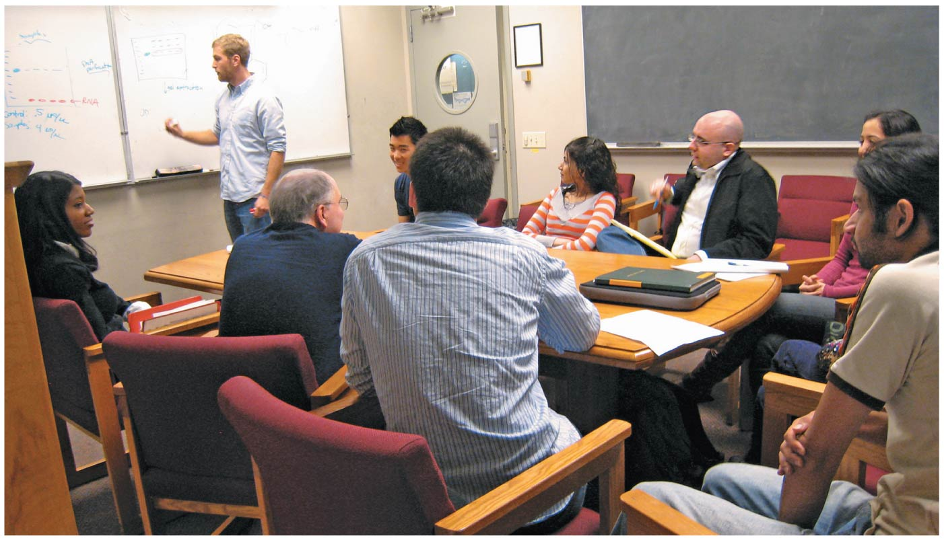
Figure 1.20
Notes:
80
Figure 1.20 Science as a social process

Slide 81
The relationship between science and society is clearer when technology is considered
The goal of technology is to apply scientific knowledge for some specific purpose
Science and technology are interdependent
Notes:
81

Slide 82
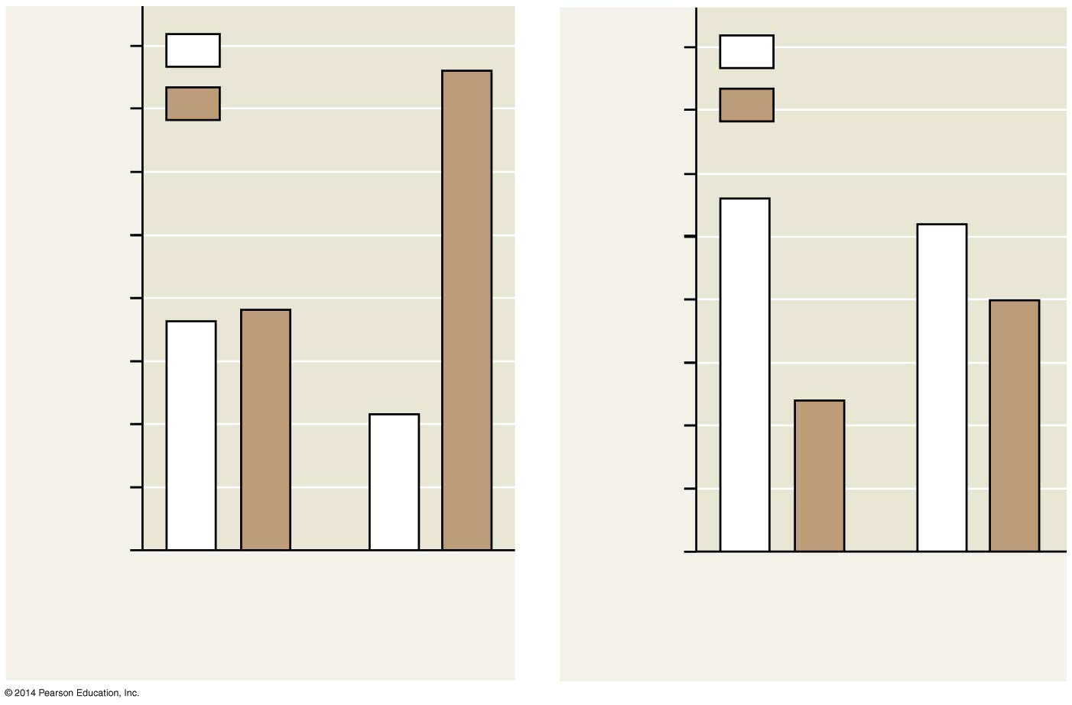
Figure 1.UN01
40
Light coat
40
Light coat
35
Dark coat
35
Dark coat
30
30
25
25
Number of mice caught
Number of mice caught
20
20
15
15
10
10
5
5
0
0
Full moon
No moon
Full moon
No moon
A: Light-colored soil
B: Dark-colored soil
Notes:
82
Figure 1.UN01 Skills exercise: interpreting a pair of bar graphs

Slide 83
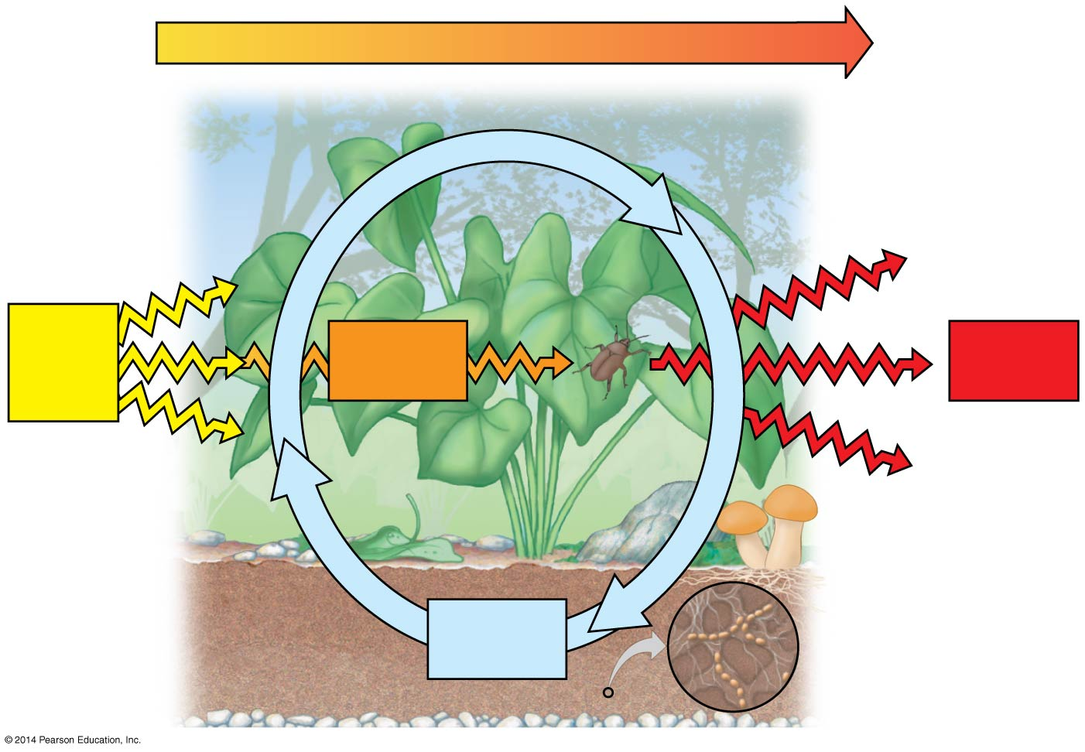
Figure 1.UN02
Energy flow
Light
energy
Chemical
energy
Heat
Decomposers
Chemical
elements
Notes:
83
Figure 1.UN02 Summary of key concepts: energy flow and chemical cycling

Slide 84
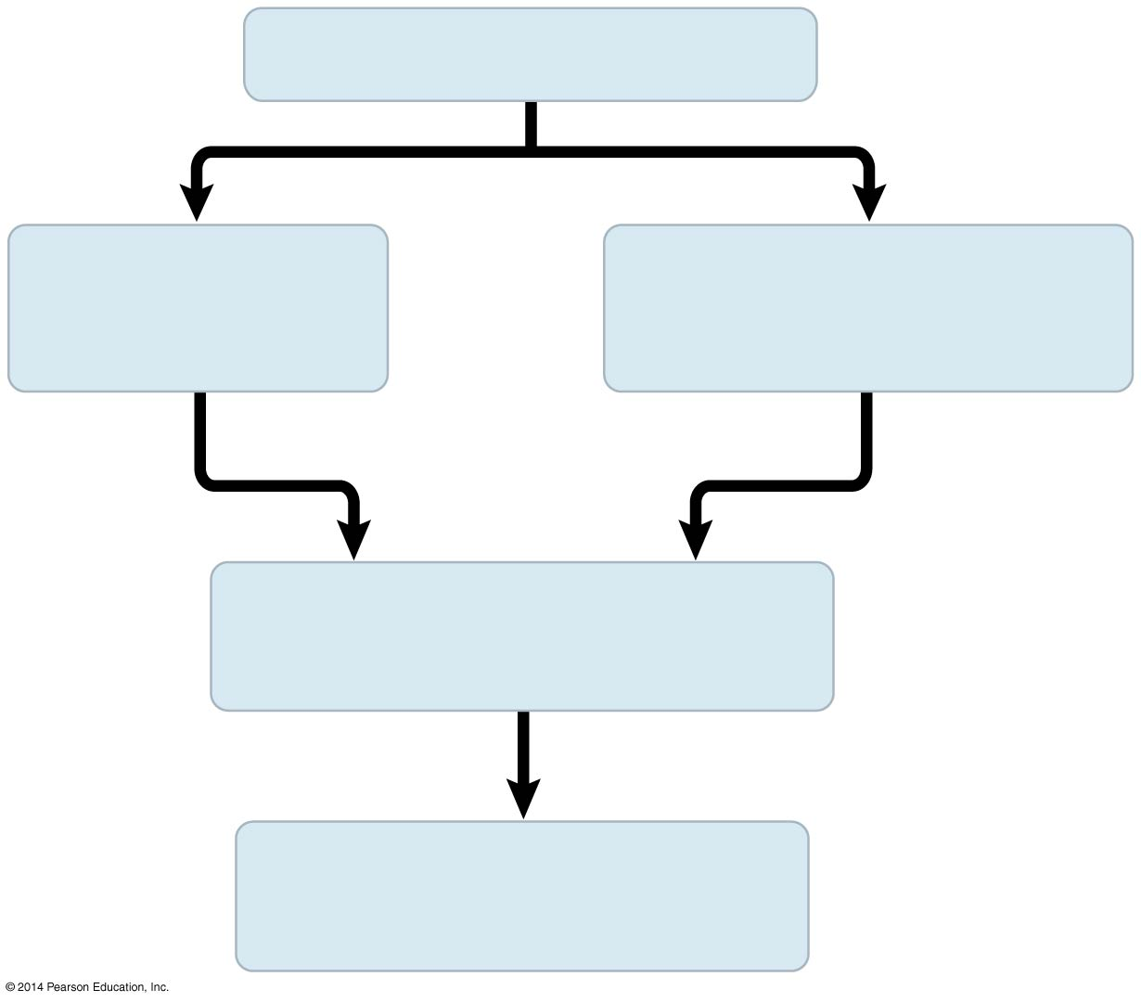
Figure 1.UN03
Population of organisms
Hereditary
variations
Overproduction of off-
spring and competition
Environmental
factors
Differences in reproductive
success of individuals
Evolution of adaptations
in the population
Notes:
84
Figure 1.UN03 Summary of key concepts: natural selection

